Slide 1
Lecture 13
Harmony in the Family
– the Basic Unit of Human Interaction

Slide 2
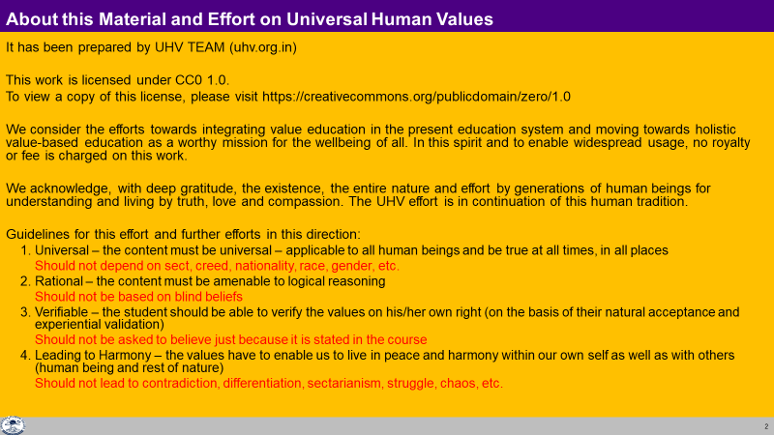

Slide 3
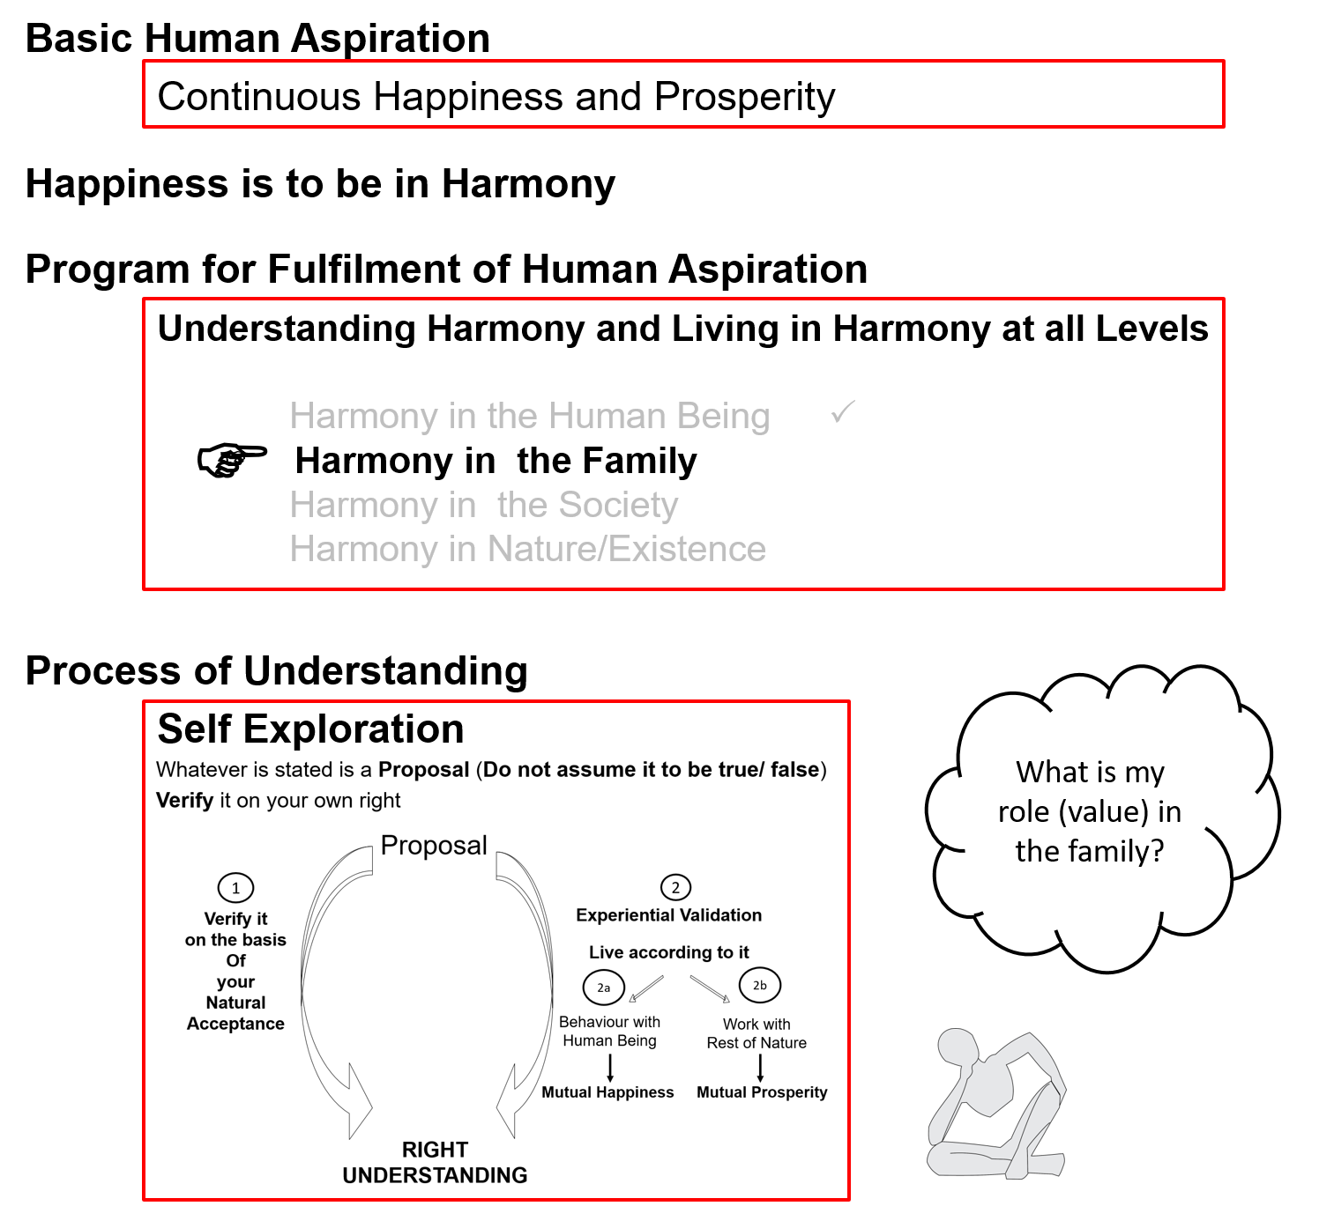
Notes:
2 mins: Key points
Basic human aspiration = continuous happiness and prosperity
Happiness = to be in harmony
Levels of our living (4 levels) = individual, family, society and nature/existence
Therefore, to live in harmony in continuity, we need to understand harmony at these 4 levels
Process of understanding = self-exploration
In this session, we will explore into harmony at the second level “harmony in the family”
Now we can bring in any second person (but let us hold off the systems in the society - we will do that when we get to the society, not now)
(do not elaborate on any point)

Slide 4
Harmony in the Family
The family is the basic unit or building block of human organisation
The major issue in the family is of fulfilment in relationship
To live in relationship, to ensure fulfilment in relationship, it is essential to understand relationship
Without understanding relationship, it isn’t possible to fulfil relationship…
e.g. Not speaking to each other… for days… opposition, divorce…
Notes:
Key point
It is necessary to understand relationship to fulfil relationship
(Without understanding relationship, it isn’t possible to fulfil relationship… )
Elaborate this for some time, as it establishes the need for understanding
Q: In relationship, what is important for you to convey to the other, or to receive from the other?
Words
Behaviour
Feeling
Ultimately, it is the feeling that is the most significant in relationship with human being
If the feeling is naturally acceptable, the other accepts me, then rightly interprets my words also

Slide 5
Relationship
We had explored into the question “can we live in relationship without understanding relationship?”
Right understanding about relationship is necessary for fulfillment in relationship
We had also explored "the unhappiness in our families is more due to lack of physical facility or more due to lack of fulfillment in relationship?”
The major issue in family is that of relationship; physical facility (and body) is used as a means
As long as we consider human being to be body, it is not possible to understand relationship; and without understanding relationship, it is not possible to fulfill relationship, even though we do want to fulfill relationship.
We are trying to assume relationship on the basis of body and trying to fulfill relationship on the basis of body, and it does not work, inspite of all good intentions
In this module we explore into relationship with the basic clarity that human being is the co-existence of self and body

Slide 6
Human Being
Human Being is the co-existence of Self and Body
The Self is central to human existence
The Body is used as an instrument by the Self
The need of the Self is continuous happiness. For this, the program of the Self is:
To understand harmony and
To live in harmony
The need of the Body is physical facility
It is required for the nurturing, protection and right utilisation of the Body
(production, protection and right utilisastion of physical facility is a part (< 1/4th) of my program)
at all levels of being
  As an individual human being
  As a member of the family
  As a member of society
  As an unit in nature/existence

Slide 7
Family
The family is the next larger order – it is the basic unit or building block of human organisation
In the family, there are parents, grandparents, brothers, sisters, children, old people, uncles, aunts, cousins; and so many relatives and friends…
Our basic grooming for living in relationship begins in the family
The major issue in family is that of relationship
To live in relationship, it is essential to understand relationship
Without understanding relationship, isn’t possible to fulfil relationship…
e.g. Not speaking to each other… for days… opposition, divorce…

Slide 8
Family
Is relationship Important?
Really? Then why do we stop talking with the other for days and weeks?
So is ego more important than relationship?
We do want to live in relationship but as long as we consider human being to be body, it is not possible to understand relationship
Without understanding relationship, it is not possible to fulfill relationship, even though we do want to
i.e. if we are trying to assume relationship on the basis of body and trying to fulfill relationship on the basis of body, it does not work, in spite of all good intentions

Slide 9
Relationship
These are the four aspects to understand about relationship
  Relationship is – between one self (I₁) and another self (I₂)
  There are feelings in relationship – in one self (I₁) for the other self (I₂)
  These feelings can be recognized – they are definite (9 Feelings)
  Their fulfilment, evaluation leads to mutual happiness
Feelings in Relationship:
We will explore each of these aspects one by one
1- Trust fo”okl FOUNDATION VALUE
2- Respect lEeku
3- Affection Lusg
4- Care eerk
5- Guidance okRlY;
6- Reverence J)k
7- Glory xkSjo
8- Gratitude —rKrk
9- Love izse COMPLETE VALUE

Slide 10
1. Relationship is
We are related to each other – whether we understand it or not
The relationship is already there, we only need to understand it
When we understand relationship
    We are able to see that relationship is there
    We are able to accept the relationship and
    think in terms of fulfilling the relationship
When we don’t understand it, the relationship is still there but:
    We are not able to see the relationship
    We are not able to accept the relationship and therefore
    We are not able to fulfill the relationship

Slide 11
1. Relationship is – between one self (I₁) and other self (I₂)
Of course the relationship is between one human being and another human being
Now if you look at the human being,
  who is recognising the relationship – the self or the body?
  who is having feelings in the relationship – the self or the body?
The Self is playing a central role in recognising the relationship… and fulfilling the relationship
So, in that sense,
  Relationship is between one self (I₁) and other self (I₂)
  The body is used as an instrument in expressing – as an when required

Slide 12
Harmony in the Family
Relationship is – between one self (I₁) and another self (I₂)
There are feelings in relationship – in one self (I₁) for the other self (I₂)
These feelings can be recognized – they are definite (9 Feelings)
Their fulfilment, evaluation leads to mutual happiness
Feelings in relationship:
1- Trust fo”okl FOUNDATION VALUE
2- Respect lEeku
3- Affection Lusg
4- Care eerk
5- Guidance okRlY;
6- Reverence J)k
7- Glory xkSjo
8- Gratitude —rKrk
9- Love izse COMPLETE VALUE

Slide 13
2. There are Feelings in Relationship – in one Self (I₁) for the other Self (I₂)
Feelings are fundamental to relationship
Feelings play a central role in relationship
Check if feelings are of significance in relationship
These feelings are in the Self (not in the Body)
Check if feelings are in the self or body?
We can understand these feelings only when we understand the Self
If we do not understand the Self, we do not understand the feelings… nor the relationship
And when we do not understand relationship, we are unable to fulfil the relationship
The major crisis we are facing in relationship today is because of the failure to understand the Self… and the feelings in the Self
We are trying to assume relationship on the basis of Body and trying to fulfill relationship on the basis of Body; and it does not work, inspite of all good intentions

Slide 14
Self Reflection
For fulfilling relationship in the family, what do you think of –
physical facility (good food, gifts…) or
feelings (expressing your feelings like trust, respect…)

Slide 15
3. These feelings can be recognized – they are definite (9 Feelings)
We can recognise them, investigate them and understand that they are naturally acceptable to us in relationship with the other human being
These are the 9 feelings
Are these feelings naturally acceptable to you?
Are these feelings naturally acceptable to the other? … to everyone?
1- Trust fo”okl FOUNDATION VALUE
2- Respect lEeku
3- Affection Lusg
4- Care eerk
5- Guidance okRlY;
6- Reverence J)k
7- Glory xkSjo
8- Gratitude —rKrk
9- Love izse COMPLETE VALUE

Slide 16
3. These feelings can be recognized – they are definite (9 Feelings)
Each of us can investigate if these feelings are naturally acceptable to us or not
What is naturally acceptable to you?
  Feeling of trust or mistrust, opposition?
  Feeling of respect or disrespect?
  Feeling of affection or jealousy?
  Feeling of care or exploitation?
  Feeling of guidance or misguidance, confusion?
  Feeling of reverence or irreverence?
  Feeling of glory or inglorious feelings?
  Feeling of gratitude or ingratitude?
  Feeling of love or hatred?
  If you have these feelings, will you feel comfortable within?
  When you share these feelings with the other, will s(he) feel comfortable/uncomfortable?

Slide 17
3. These feelings can be recognized – they are definite (9 Feelings)
Feelings in relationship:
Are these feelings naturally acceptable to you?
Are these feelings naturally acceptable to the other? … to everyone?
1- Trust fo”okl FOUNDATION VALUE
2- Respect lEeku
3- Affection Lusg
4- Care eerk
5- Guidance okRlY;
6- Reverence J)k
7- Glory xkSjo
8- Gratitude —rKrk
9- Love izse COMPLETE VALUE

Slide 18
4. Their fulfilment, evaluation leads to mutual happiness
These feelings are naturally acceptable to me. Therefore when I have these feelings, I am happy
They are naturally acceptable to the other also. Thus, when I share these feelings with the other, it leads to happiness of the other… it leads to mutual happiness
Find out
  If you feel happy when you have these feelings (like trust, respect…) in you?
  If the other feels happy when you express feelings like trust, respect… to the other?
Can you see that
  The absence of one or more of these feelings leads to problems in relationship?
  Physical facility can not compensate for lack of feelings? (It is definitely required for the Body)
  [try to observe what happens to you when the other ignores you, contradicts you, opposes you…]
Understanding Relationship in me
Feeling of Relationship in me
Happiness in Me
----
Acceptance of Relationship with Other
Sharing the Feeling with Other by me
(through Body, as and when required)
----
Recognition/Evaluation of Feeling by Other
Happiness in Other
Mutual Happiness

Slide 19
Analysis of Current Situation
If I do not have these feelings, I am unhappy
(I do not have these feelings if I have not understood the Self, not understood relationship, not understood the feelings in relationship)
If I do not have these feelings in me, I try to get them from the other in so many ways
(agree with the other, do their bidding, wear fashionable clothes, get a special haircut, climb a mountain peak, etc.)
  If the other expresses right feelings to me, I am “happy”
  If the other does not express right feelings to me, I am “unhappy”
If the other also does not have these feelings, then s(he) is also trying to get these feelings from me!
(It is like we are begging for feelings from each other – and our bowls are empty!)

Slide 20
The Way Forward
The most fundamental thing in relationship is to understand these feelings. If I understand these feelings, then I have these feelings in me
If I understand the feeling of respect, I have feeling of respect in me
If I have feeling of respect, I am comfortable (in harmony) within myself. I am happy
When I have the feeling of respect within, I naturally express it to the other. This feeling is naturally acceptable to the other… it makes the other also happy
In this way, understanding the feeling, having the feeling, expressing the feeling and its right evaluation (by both) leads to mutual happiness
Right evaluation is required to verify
    whether I have these feelings or not
    whether I have expressed these feelings to the other or not
    whether it has reached to the other or not… and ultimately
    whether the result is mutual happiness or not

Slide 21
Harmony in the Family
Relationship is – between one self (I₁) and another self (I₂)
There are feelings in relationship – in one self (I₁) for the other self (I₂)
These feelings can be recognized – they are definite (9 Feelings)
Their fulfilment, evaluation leads to mutual happiness
Feelings in relationship:
From the next lecture, we can start exploring each of these feelings one by one…
Right Understanding
Right Feeling
Fulfilment in Relationship – Mutual Happiness
Harmony in the Family
1- Trust fo”okl FOUNDATION VALUE
2- Respect lEeku
3- Affection Lusg
4- Care eerk
5- Guidance okRlY;
6- Reverence J)k
7- Glory xkSjo
8- Gratitude —rKrk
9- Love izse COMPLETE VALUE

Slide 22
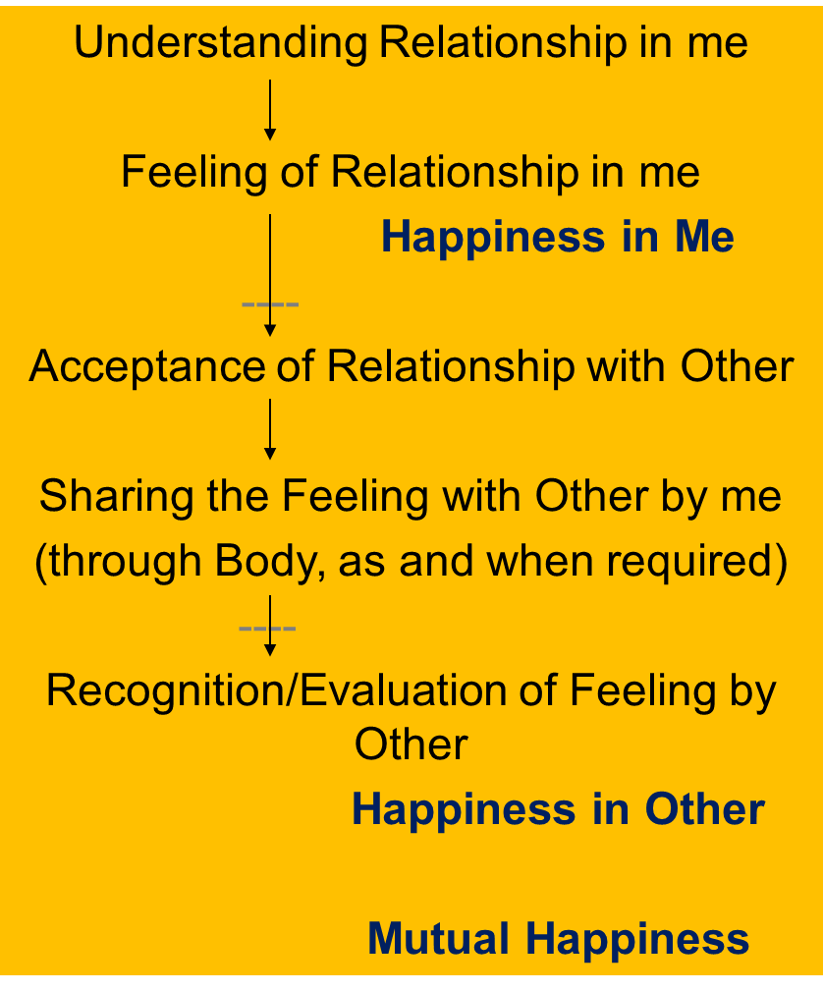
Harmony in the Family
Relationship is – between one self (I₁) and another self (I₂)
There are feelings in relationship – in one self (I₁) for the other self (I₂)
These feelings can be recognized – they are definite (9 Feelings)
Their fulfilment, evaluation leads to mutual happiness
Feelings in relationship:
From the next lecture,
we can start exploring each of these feelings one by one…
1- Trust fo”okl FOUNDATION VALUE
2- Respect lEeku
3- Affection Lusg
4- Care eerk
5- Guidance okRlY;
6- Reverence J)k
7- Glory xkSjo
8- Gratitude —rKrk
9- Love izse COMPLETE VALUE

Slide 23
Self Reflection

Slide 24
Self Reflection
Reflect on your notion of relationship – is it based on the self or on the body?
When you think about relationship, what is central
    Feelings or
    Sensation and physical facility
Do you think about
    Ensuring these feeling in yourself and expressing them to the other or
    Getting these feelings from the other
When you think of relationship, do you think of it within your family or also outside your family? (What is the scope of relationship for you)
Find out what effort is being made in our school and college education to understand relationship, and then to practice living in relationship? Then find out what is required to be done starting from home… to school… to college and in society…

Slide 25
Key Points
Lecture 13: Harmony in the Family – the Basic Unit of Human Interaction

Slide 26
Harmony in the Family
Relationship is – between one self (I₁) and another self (I₂)
There are feelings in relationship – in one self (I₁) for the other self (I₂)
These feelings can be recognized – they are definite (9 Feelings)
Their fulfilment, evaluation leads to mutual happiness
Feelings in relationship:
From the next lecture,
we can start exploring each of these feelings one by one…
1- Trust fo”okl FOUNDATION VALUE
2- Respect lEeku
3- Affection Lusg
4- Care eerk
5- Guidance okRlY;
6- Reverence J)k
7- Glory xkSjo
8- Gratitude —rKrk
9- Love izse COMPLETE VALUE

Slide 27
Feelings based on Understanding
In me – unconditional, continuous
Expression of feeling
(through Body, as and when required)
→ Harmony in the Family
Role of Education

Slide 28
My Feelings are Based on My Assumptions, My Interpretation of Events Outside
My feelings are conditional,
may change from time to time…
My feelings are decided by
my own assumptions or
outside events / behaviour of other
My state (happiness/unhappiness) is decided/dictated by the other
(I am in a state of enslavement)
Understanding of Relationship in me?
Feelings and Emotions in me
(conditional, temporary…
sometime relationship
sometime opposition)
Happiness or
Unhappiness in Me
Acceptance of Relationship by me?
Interacting with Other
…
Assumptions
Events Outside
Behaviour of Other

Slide 29
FAQs for Lecture 13
Harmony in the Family – the Basic Unit of Human Interaction

Slide 30
Question(s): Response
The major issue in relationship is fulfillment in relationship. But for that physical facility (and money) is definitely required. Why are you saying that feeling is the most important thing in relationship?
Human aspiration = continuous happiness and prosperity. It is fulfilled by right understanding + fulfilment in relationship + physical facility…
what we are saying is that to ensure fulfillment in relationship, feeling is fundamental, without the right feeling, such as respect, no amount of physical facility is going to result in fulfillment. By that we are not saying that physical facility has no role, it may have a role in the expression of the feeling. E.g. to express the feeling of affection and care, we certainly need physical facility to nurture the body of my relative.

Slide 31
Question(s): Response
If relationship exists between one Self and the other Self, what is the role of Body?
Do I need a body to feel related? Most of our interaction with others is through the Body
The body is used as a instrument by both the self, as and when required.
As human beings, we are the co-existence of self and body; therefore, different types relationship in case of human being is defined in terms of self as well as body, e.g. relationship between father and son. However, the fundamental thing in fulfillment in relationship is the feelings, e.g. feeling of gratitude and glory on the part of the son and feeling of affection, care and guidance on the part of the father.

Slide 32
Feelings based on Understanding
In me – unconditional, continuous
Expression of feeling
(through Body, as and when required)
→ Harmony in the Family
Role of Education

Slide 33
My Feelings are Based on My Assumptions, My Interpretation of Events Outside
My feelings are conditional,
may change from time to time…
My feelings are decided by
my own assumptions or
outside events / behaviour of other
My state (happiness/unhappiness) is decided/dictated by the other
(I am in a state of enslavement)
Understanding of Relationship in me?
Feelings and Emotions in me
(conditional, temporary…
sometime relationship
sometime opposition)
Happiness or
Unhappiness in Me
Acceptance of Relationship by me?
Interacting with Other
…
Assumptions
Events Outside
Behaviour of Other

Slide 34
Question(s): Response
In relationship, we must have mutual understanding or adjustment. And sometimes we even have to compromise and sacrifice. What is the role of adjustment, mutual understanding, sacrifice and compromise?
As discussed, we have to understand relationship, accept relationship, have the right feelings in relationship, this will ensure happiness within me. These feelings will be unconditional in me. With this, we have to express this feeling with the other in relationship. This all put together will lead to mutual fulfillment. If we don’t have these unconditional feelings, then any amount of adjustment, compromise and even sacrifice will not work. These things are helpful only in keeping the relationship from getting worsened or leading to breakdown.

Slide 35
Question(s): Response
I can see that it is possible to understand relationship. if I understand it, but my spouse does not, then… How to go about it?
It is essential to begin from one side atleast. An unconditional acceptance of relationship from my side will atleast ensure happiness in myself, it will further provide a base for relationship. When I express these feelings to other, he will have natural acceptance for it and therefore, it will lead to his happiness as well. But, he may not be able to reciprocate, if he does have the right understanding and unconditional acceptance of relationship, and the feelings borne out of it. In that case, fulfillment from my side will create a space in him to accept relationship on the basis of feeling of gratitude, once there is acceptance, we can have proper sharing and dialogue, which will help in the process of dialogue leading to understanding of relationship and feelings thereby.

Slide 36
Question(s): Response
One more possibility is to live separately, not have to worry about relationship. Like when I lived in the hostel, I did not have to worry about the family. Even now, I see young people are not interested in the older generation. So isn’t being independent another solution?
We have amply tried this out in the present day society, and it is certainly not working.
this is for the reason-
relationship is something natural and hence necessary for my happiness and happiness of the other.
majority of our functions are in mutual dependence and hence, isolation creates all kinds of problems in the family and society. For example if we don’t have three generations in the family living together, we will need crest for children and old-days home for the old people and so on.

Slide 37
Question(s): Response
Why only 9 feelings? What about truth, honesty, hard work, sincerity, generosity… ? Then we also have other traditional values… and our constitutional values, How are all these related?
What is of importance is
realsation and understanding of relationship, harmony and co-existence (truth),
acceptance of these relationship, harmony and co-existence (feeling of love) and
commitment for fulfillment of relationship, harmony and co-existence (compassion)
it is the feeling of relationship which is naturally acceptable to every human being, and not the feeling of opposition. This feeling of relationship we want to have for one, many and ultimately for everyone. When we have the feeling of relationship for everyone, it is called love.
Cross reference of key values, particularly the often used ones constitutional values

Slide 38
Question(s): Response
Why only 9 feelings? What about truth, honesty, hard work, sincerity, generosity… ? Then we also have other traditional values… and our constitutional values, How are all these related?
This love is called complete value, and it includes all the feelings in it. So this is what is the most important value, and we must take care of this. Once this is in place, other feelings can be seen as expression of this feeling of love at different levels. For example, affection is an expression of this feeling of love at the level of one or many; care is when this affection is expressed in terms of responsibility of taking care of body.
This feeling of love, in essence, is common in most of the traditional systems. Some systems have placed it as non-violence, that is not having the feeling of hatred for any one. Detailed expression of this feeling of love or non-violence may be different in different traditions.
have
Cross reference of key values, particularly the often used ones constitutional values

Slide 39
Question(s): Response
Why only 9 feelings? What about truth, honesty, hard work, sincerity, generosity… ? Then we also have other traditional values… and our constitutional values, How are all these related?
Let us see this in case of constitutional values such as freedom, fraternity and equality.
Freedom (svatantrata) is being self- organised, which in essence would mean that I understand what is naturally acceptable to me (i.e. relationship, harmony and co-existence) and I am being with that (i.e. relationship, harmony and co-existence), so that I am in harmony and happiness within.
Fraternity in its ultimate would mean having the feeling of love i.e. accepting everyone as related to him, treating everyone as one’s relative.
Equality will be a natural outcome of this feeling of love. A mother not only gives equal opportunity to the child but better than herself.

Slide 40
Question(s): Response
What about the negative feelings like anger? These are also there
Many people are happy by seeing others unhappy. How do we relate to such people?
Negative feelings are basically the absence of naturally acceptable feelings. Anger for example is an expression of the feeling of trust. This we will see when we talk about the feeling of trust in detail.
Such people are having feeling of jealousy with others, and with this unnatural feeling, they are in contradiction, in unhappiness within. We need to help them understand and see the relationship, then they will be able to accept the relationship and with the feeling of affection, they will start thinking of making others happy.

Slide 41
Question(s): Response
What is the difference between feelings and emotions?
Is mood same as emotion?
I get the feelings I want from my family members or someone else. So if I can manage to get feelings like this, what is the problem? I mean, why do I have to ensure these feelings in myself?
We are using feeling here in the sense of naturally acceptable feeling; emotions however is used for all types of feelings, whether naturally acceptable or not.
Generally, mood is the state of imagination (DTE). It is certainly based on the feeling / emotion
If you can work out this way, there is no problem from our side. But, you check, whether you want continuity of these feelings or not and whether you can ensure getting these feelings from others in continuity. If not, then it is important that you have these feelings in your self based on right understanding of relationship, as you can ensure the continuity of these feelings in yourself and that can be source of continuous happiness for you, and it can also help ensuring mutual happiness.

